Slide 1
IS1500: Introduction to Web Development
Integrating Multimedia Content
Martin Schedlbauer, Ph.D.
m.schedlbauer@neu.edu

Slide 2
Objectives
At the end of this module, you will be able to:
Link images in an HTML page using the <img> tag
Differentiate between the different image file formats, including GIF, JPG, TIFF, and PNG
Use custom RGB colors
Render text in non-standard fonts
Embed videos and audio streams

Slide 3
Notes for Content
Online tools for image file type change, resizing, animated gifs
Example of animated gif
Example of transparency in gif and png
Creating a thumbnail
Streaming video vs download example
Same with audio

Slide 4
Image Sources
Integrating Multimedia Content

Slide 5
Images
Images are graphics elements that can enhance a website because they:
deliver a visual message
make the website more personal
prompt action
improve aesthetics
Use photos and images creatively:
Tilt or border them to create additional whitespace
Use dithering or other enhancement techniques

Slide 6
Sources for Images
Create your own images:
Take photos with a digital camera
Scan images or photos with a scanner
Draw an illustration
Digital cameras:
Watch resolution (1.2 megapixels is fine for the web but not for photo printing)

Slide 7
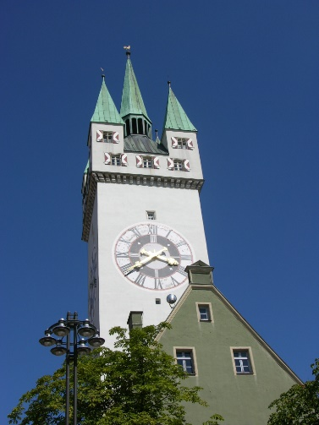
Examples of Images
Hand drawn Illustration
Photo taken with a
Digital Camera
Image from freedesignfile.com. And under a Creative Commons License.
Scanned Image from a Catalog

Slide 8
Using Images from the Web
Images can be located on the web:
Observe copyright
Purchase a license for an image, but watch license restrictions
Follow the Creative Commons license type
Use image at the right size and resolution

Slide 9
Creative Commons License
A Creative Commons (CC) license is one of several public copyright licenses that allow the free distribution of copyrighted work.
A CC license free use of a work.
There are several types of CC licenses.
For example, an author might provide a CC license to allow only non-commercial uses of their own work.

Slide 10
Scanning Images
Use a flatbed, sheetfed, or drum scanner:
Scan images at 72dpi (dots per inch)
Use higher resolution if images will be manipulated or printed, e.g., 150dpi
Scan illustrations at 256 colors; more colors increases the file size but not the look
Save images in TIFF to retain all colors and quality

Slide 11
Screen Resolution
pixel
scanline
height
width

Slide 12
Pixels and Color
Pixels are individual dots on the screen and in an image.
Each pixel is a number that represents the color of the “dot”.
Colors are Red, Green, and Blue triples consisting of a certain number of bits:
8 bits per color = 2²⁴ = 16.7 million different colors

Slide 13
Image Scaling
Scaling of images to the right size is done by the browser.
Images that are larger take time to download but do not lead to higher display quality
Watch the different resolutions of screens on which page will be viewed (e.g., Retina display)

Slide 14
Image File Formats
Integrating Multimedia Content

Slide 15
Image File Formats
Image File Formats
JPG
GIF
PNG
TIFF
EPS

Slide 16
Image Compression
Images are often compressed to save storage space and reduce network download time (important for metered networks).
Compression can be “lossless” or “lossy”:
“Lossless”: the original image pixels are retained
“Lossy”: pixels that won’t affect image quality very much are removed resulting in better compression

Slide 17
Image Formats and Compression
Compression
Lossless
GIF
PNG
Lossy
JPG
TIFF

Slide 18
Image File Format: GIF
GIF (Graphics Interchange Format)
Only 256 colors, so lower vibrancy
Allows for animated GIFs
Interlacing makes for quicker viewing while downloading
Separate background
Large files as compression is lossless, but no quality is lost

Slide 19
Animated GIFs
Multiple GIF images in a single file that are displayed with programmable delay.
http://commons.wikimedia.org/wiki/File:Seven_segment_display-animated.gif

Slide 20
Image File Format: PNG
PNG
256 colors with transparency or 16.7 million colors
Similar to GIF and expected to replace GIF
Larger files than JPG as compression is lossless, but smaller than GIF
Capability of embedding text within images so that images can be indexed by search engines

Slide 21
Image File Format: TIFF
TIFF
Large, but highest quality
Lossless

Slide 22
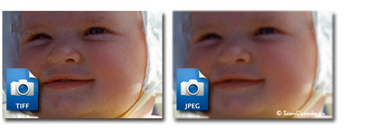
Example: TIFF versus JPG
Notice how the TIFF file is much clearer compared to the JPG file, but it’s also much larger.

Slide 23
File Size Differences
Northeastern logo at a resolution of 80×76:
File Type | Size | % of TIF | Comment
TIF | 14.5kb | 0%
PNG | 11.3kb | 78% | Lossless compression; full color
JPG, High Quality | 4.89kb | 34% | No transparency; full color; low compression
GIF | 3.87kb | 26% | Fewer colors
TIFF
PNG
JPG
GIF

Slide 24
File Size Differences
File Type | Average File Size
TIFF, Uncompressed | 901KB
JPG, High Quality | 319KB
JPG, Medium Quality | 188KB
JPG, Low Quality / High Compression | 50KB
JPG, Absurdly High Compression | 18KB
PNG, Lossless Compression | 741KB
GIF, Lossless Compression, But only 256 colors | 286KB

Slide 25
Example: TIFF versus GIF
The difference between TIFF and GIF is even more pronounced than TIFF vs JPG as GIF reduces the number of colors as well as uses compression.
TIFF
GIF

Slide 26
Scaling Images
Images can be scaled by the browser or through an image processing program, such as Photoshop and even Paint.
BUT: Scaling above an image’s native size leads to “blurriness”.

Slide 27
Thumbnails
Thumbnails are smaller versions of an image used for previewing.
Create separate thumnail files; do not simply scale the larger images… why?

Slide 28
In Practice
In practice, it’s either TIFF or JPG, rarely GIF, for photo images.
Background images are sometimes in PNG as it allows transparency.
http://www.digitalmemoriesonline.net/scan/output/jpeg_vs_tiff.htm

Slide 29
The <img> Tag
Integrating Multimedia Content

Slide 30
LOWSRC Attribute for <img>
If a LOWSRC image is specified, browser loads that first and then the actual image
Results in faster initial display if the LOWSRC image is smaller (and of course of lower quality)

Slide 31
Streaming Video and Audio
Integrating Multimedia Content

Slide 32
Animation
Animated GIFs
Flash
Java Applets
Microsoft Silverstream

Slide 33
Downloading vs. Streaming
Web audio and video can be downloadable or streaming.
Downloadable media must be downloaded fully before it can be played.
Streamed media start playing after a local buffer is filled. The buffer is kept full while the media is playing.

Slide 34
Downloading vs. Streaming
 | Advantages | Disadvantages
Downloading | Content can be accessed offline Uses HTTP and does not require special media servers | Can take a long time to download Content is not accessible until fully downloaded No previewing of content Requires local storage Content is distributable and digital rights are difficult to enforce
Streaming | Seeking and random access Does not require local storage Previewing of content possible Does not require special software on browser Digital rights more easily enforceable | High bandwidth requirements for continuous streaming Requires a media server on the web server Re-playing content requires re-sending of the same content

Slide 35
Audio
Audio files must be encoded in a format that the browser can play back.
Quality and recording format affects file size:
Mono vs. stereo
Sampling rate
8kHz is fine for voice, 22kHz for web audio
48kHz is higher quality audio
Bit depth
8 bit audio vs 16 bit vs 128 bit

Slide 36
Codecs
Codecs are compression algorithms that can greatly reduce the file size.
Most compression algorithms are “lossy”, so quality is reduced to achieve smaller file sizes.
Encoding with a codec requires a player that supports the codec when playing back.

Slide 37
Streaming Audio
Streaming audio requires a streaming media server.
Files play back as they download, so audio starts almost immediately.
RealAudio and Quicktime are common streaming formats.
Windows Media format (WAV) uses better codecs but files are larger and Windows only.

Slide 38
Stream Hosting
Most websites use hosting platforms to handle streaming and media formats.
Video:
YouTube
Vimeo
Viddler
Audio:
EdgeCast

Slide 39
Embedding Audio and Video

Slide 40
Audio Element
<audio>: To play an audio file
<audio controls> <source src="horse.ogg" type="audio/ogg"> <source src="horse.mp3" type="audio/mpeg"> Your browser does not support the audio element. </audio>

Slide 41
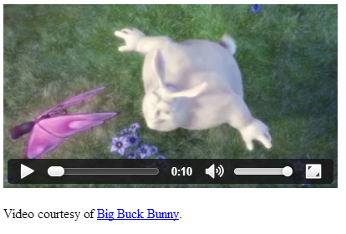
Video Element
<video>: To play a video file
<video width="400px" controls>
<source src="mov_bbb.mp4" type="video/mp4">
<source src="mov_bbb.ogg" type="video/ogg">
Your browser does not support HTML5 video.
</video>
<p>
Video courtesy of
<a href="http://www.bigbuckbunny.org/" target="_blank">Big Buck Bunny</a>.
</p>

Slide 42
Summary, Review, & Questions…

