Slide 1
IS1500: Introduction to Web Development
Using Markup Languages: HTML & Markdown
Martin Schedlbauer, Ph.D.
m.schedlbauer@neu.edu

Slide 2
Basic HTML Page Layout

Slide 3
What is HTML?
HTML is a language for formatting web pages:
HTML stands for Hyper Text Markup Language
HTML is not a programming language, it is a markup language
A markup language is a set of markup tags
The purpose of the tags are to describe the layout and formatting of page content

Slide 4
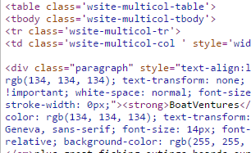
Role of HTML
The web server generates the web page as HTML and send sit to the browser for display.
You can inspect any web page’s HTML:

Slide 5
HTML Markup Tags
HTML markup tags are usually called HTML tags
HTML tags are keywords (tag names) surrounded by angle brackets like <html>
HTML tags normally come in pairs like <b> and </b>
The first tag in a pair is the start tag, the second tag is the end tag
The end tag is written like the start tag, with a forward slash before the tag name
Start and end tags are also called opening tags and closing tags

Slide 6
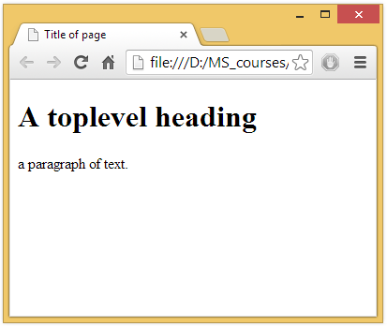
A Simple HTML Page
<!DOCTYPE html>
<html>
<head>
<title>Title of page
</title>
</head>
<body>
<h1>A toplevel heading
</h1>
<p>a paragraph of text.
</p>
</body>
</html>

Slide 7
Editing HTML Files
You can use any text editor, such as Notepad or JEdit to create and modify HTML files.
A browser can load local HTML files and render them – they do not have to be stored on a web server.
To publish them on the web, custom HTML pages must be stored on a web server, such as AwardSpace or BlueHost.

Slide 8
Previewing HTML
Use an interactive editor to preview HTML while typing:
SquareFree
CollabEdit
See Resources/Tools on the course website.

Slide 9
Warning
The HTML pasted into Weebly may look different because Weebly overrides the style settings.

Slide 10
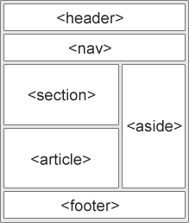
HTML 5 Semantic Elements
HTML5 offers new semantic elements to clearly define different parts of a web page:
<header>
<nav>
<section>
<article>
<aside>
<footer>

Slide 11
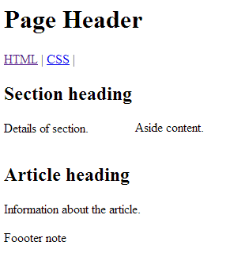
HTML 5 Semantic Elements
<header>
<h1>Page Header</h1>
</header>
<nav>
<a href="/html/">HTML</a> |
<a href="/css/">CSS</a> |
</nav>
<section style="display : inline-block;">
<h1>Section heading</h1>
<p>Details of section.</p>
</section>
<aside style="display : inline-block;">
<h4>Aside heading</h4>
<p>Aside content.</p>
</aside>
<article>
<h1>Article heading</h1>
<p>Information about the article.</p>
</article>
<footer> <p>Foooter note</p></footer>

Slide 12
Essential HTML Markup Tags

Slide 13
Paragraphs
Paragraphs are sections of content with whitespace after the content.
<p>a paragraph of text.</p>
<p>another paragraph.</p>

Slide 14
Formatting
HTML uses tags like <b> and <i> for formatting output, like bold or italic text
More formatting tags at: http://www.w3schools.com/html/html_formatting.asp

Slide 15
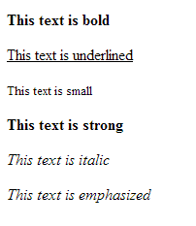
Formatting (contd.)
<p><b>This text is bold</b></p>
<p><u>This text is underlined</u></p>
<p><small>This text is small</small></p>
<p><strong>This text is strong</strong></p>
<p><i>This text is italic</i></p>
<p><em>This text is emphasized</em></p>
Bold
Underline
Small
Strong
Italics
Emphasis

Slide 16
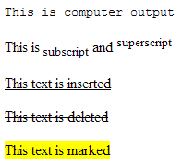
Formatting (contd.)
<p><code>This is computer output</code></p>
<p>This is<sub> subscript</sub> and <sup>superscript</sup></p>
<p><ins>This text is inserted</ins></p>
<p><del>This text is deleted</del></p>
<p><mark>This text is marked</mark></p>
Code
Sub
Super
Ins
Del
Mark

Slide 17
Line Breaks
To start a new line of text, use the self-enclosing <br/> tag.
Whitespace, spaces, and line formatting is ignored by the browser.
To add extra spaces, use the element &nbsp;
This is the same line <br />divided by &nbsp;&nbsp;&nbsp; and a line break.

Slide 18
Horizontal Lines
Horizontal lines can be added as a visual spacer: <hr width="50%"/>
Horizontal lines have no content, so a self-enclosing tag is used.
There are no vertical lines…
The width attribute determines line width
This is line one.
<hr />
This is line two.

Slide 19
Headings
Headings are used to provide titles to page sections.
There are six heading levels:
<h1> through <h6>
The browser determines the formatting and fonts style used for the headings.
Formatting can be changed using style sheets (described using CSS).

Slide 20
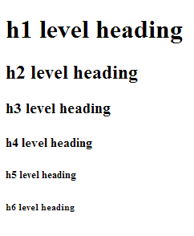
Headings (contd.)
<!DOCTYPE html>
<html>
<body>
<h1>h1 level heading</h1>
<h2>h2 level heading</h2>
<h3>h3 level heading</h3>
<h4>h4 level heading</h4>
<h5>h5 level heading</h5>
<h6>h6 level heading</h6>
</body>
</html>

Slide 21
Nesting HMTL Tags
Tags must be nested properly:
The 2nd example above works, because the browser is lenient in some cases.
Never rely on this. It might produce unexpected results and/or errors if you do not nest tags properly.
<p>
<b>a paragraph of bold text.</b>
</p>
<p>
<b>a paragraph of bold text.
</p></b>

Slide 22
Images

Slide 23
Images
To include an image, use:
If no width and height are specified, then the images full size is used.
Scaling is done by the browser, so watch for large images as they take a long time to download.
<img src="smiley.gif" width="100" height="100" />

Slide 24
<img> Attributes
alt - Specifies an alternate text for an image
height - Specifies the height of an image in pixels or as percent
width - Specifies the width of an image
src - Specifies the URL of an image
<img> tag also supports the Global attributes (style, hidden, etc.) and Event attributes (onload, onresize, etc) in HTML

Slide 25
Alternate Text
If an image cannot be loaded, then the alternate text is displayed:
The alt attribute is also used by screen readers for visually impaired users.
<img src="image.jpg" width="100" height="100" alt="alt text"/>

Slide 26
Hyperlinks

Slide 27
Links
Links to other pages are defined using the anchor tag <a>:
“href” attribute of <a> tag indicates the link URL
Link to <a href="http://www.w3schools.com"> W3Schools HTML Tutorial</a>

Slide 28
Opening a New Window/Tab
To open a linked resource in a new window or tab, use the target attribute
Looks like a normal link, but opens in a new window or tab
<a href="http://www.cnn.com" target="_blank">
News of the Day
</a>

Slide 29
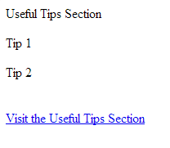
Links within a page
Links to various sections within the same page are defined using ‘id’ attribute of anchor tag:
Clicking the link takes the user to ‘Useful Tips Section’
<a id="tips">Useful Tips Section</a>
<p>Tip 1</p>
<p>Tip 2</p>
<br />
<a href="#tips">Visit the Useful Tips Section</a>

Slide 30
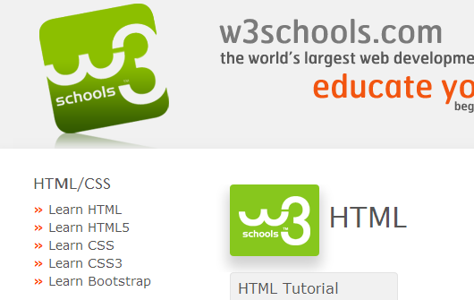
Image Links
Links can also be added to images:
<a href="http://www.w3schools.com">
<img src="smiley.gif" width="100" height="100" /></a>
After clicking
Before clicking

Slide 31
Lists

Slide 32
Lists
Unordered lists:
<ul>
Specify each list item with:
<li>
<ul>
<li>Coffee</li>
<li>Tea</li>
<li>Milk</li>
</ul>

Slide 33
Lists
Ordered lists:
<ol>
Specify each list item with:
<li>
<ol>
<li>Coffee</li>
<li>Tea</li>
<li>Milk</li>
</ol>

Slide 34
Lists
Ordered lists variations:
<ol type="A">
<li>Coffee</li>
<li>Tea</li>
<li>Milk</li>
</ol>
<ol type="a">
<li>Coffee</li>
<li>Tea</li>
<li>Milk</li>
</ol>

Slide 35
Lists
Ordered lists variations:
<ol type="I">
<li>Coffee</li>
<li>Tea</li>
<li>Milk</li>
</ol>
<ol type="i">
<li>Coffee</li>
<li>Tea</li>
<li>Milk</li>
</ol>

Slide 36
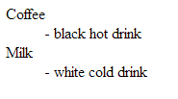
Definition Lists
A definition list has items with descriptions.
<dl>
<dt>Coffee</dt>
<dd>- black hot drink</dd>
<dt>Milk</dt>
<dd>- white cold drink</dd>
</dl>

Slide 37
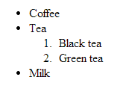
Nested Lists
A list can be nested within a list.
<ul>
<li>Coffee</li>
<li>Tea
<ol>
<li>Black tea</li>
<li>Green tea</li>
</ol>
</li>
<li>Milk</li>
</ul>

Slide 38
Tables

Slide 39
Tables
Tables are spreadsheets with rows and columns:
<table border="1">
<tr>
<td>row 1, cell 1</td>
<td>row 1, cell 2</td>
</tr>
<tr>
<td>row 2, cell 1</td>
<td>row 2, cell 2</td>
</tr>
</table>

Slide 40
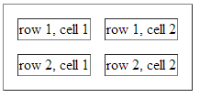
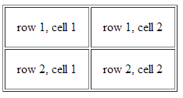
Cell spacing & padding
<table cellspacing="15" border="1">
<tr>
<td>row 1, cell 1</td>
<td>row 1, cell 2</td>
</tr>
<tr>
<td>row 2, cell 1</td>
<td>row 2, cell 2</td>
</tr>
</table>
<table cellpadding="15" border="1">
<tr>
<td>row 1, cell 1</td>
<td>row 1, cell 2</td>
</tr>
<tr>
<td>row 2, cell 1</td>
<td>row 2, cell 2</td>
</tr>
</table>

Slide 41
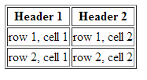
Table Headers & Border
<table border="1">
<tr>
<th>Header 1</th>
<th>Header 2</th>
</tr>
<tr>
<td>row 1, cell 1</td>
<td>row 1, cell 2</td>
</tr>
<tr>
<td>row 2, cell 1</td>
<td>row 2, cell 2</td>
</tr>
</table>

Slide 42
Table Row Spans
<table border="1">
<tr>
<th>First Name:</th>
<td>Bill Gates</td>
</tr>
<tr>
<th rowspan="2">Telephone:</th>
<td>555 77 854</td>
</tr>
<tr>
<td>555 77 855</td>
</tr>
</table>

Slide 43
Table Column Spans
<table border="1">
<tr>
<th>Name</th>
<th colspan="2">Telephone</th>
</tr>
<tr>
<td>Bill Gates</td>
<td>555 77 854</td>
<td>555 77 855</td>
</tr>
</table>

Slide 44
Columnar Layout

Slide 45
Arranging Items in Columns
HTML5 has a different way of arranging items in columns instead of a table.
<div style="float: left; width: 50%;">
<ul>
<li>Left Item 1</li>
<li>Left Item 2</li>
</ul>
</div>
<div style="float: right; width: 50%;">
<ul>
<li>Right Item 1</li>
<li>Right Item 2</li>
</ul>
</div>

Slide 46
Embedding with <iframe>

Slide 47
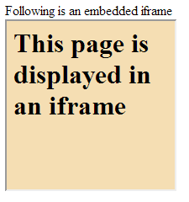
iFrame
Used to embed a web page within a web page
Use the height and width attributes to specify the size
Following is an embedded iframe <br>
<iframe src="demo_iframe.htm" width="200" height="200"></iframe>
Used to embed social networking tags, blogs, maps, etc. from other sites

Slide 48
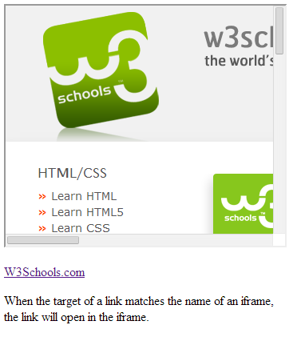
iFrame as a Target for a Link
<iframe width="100%" height="300px" src="demo_iframe.htm" name="iframe_a"></iframe>
<p><a href="http://www.w3schools.com" target="iframe_a">W3Schools.com</a></p>
<p>When the target of a link matches the name of an iframe, <br> the link will open in the iframe.</p>

Slide 49
Embed Youtube Video in iFrame
<body>
<p> Video embedded in an iframe: </p>
<iframe width="420" height="345"
src="http://www.youtube.com/embed/XGSy3_Czz8k">
</iframe>
</body>

Slide 50
Embed using <embed> tag
<body>
<p> Video embedded using embed tag: </p>
<embed width="420" height="345"
src="http://www.youtube.com/embed/XGSy3_Czz8k">
</embed>
</body>

Slide 51
<iframe> vs <embed>
iframe - Importing another webpage in the main page
Primarily used to include resources from other domains but can be used to include content from the same domain as well
embed - Importing (or) using another format file like media files, documents in a web page
Used to embed content for browser plugins

Slide 52
HTML via Markdown

Slide 53
Markdown
A text-to-HTML conversion tool for web writers
Allows you to write using an easy-to-read, easy-to-write plain text format, then convert it to structurally valid XHTML (or HTML)
A software tool that converts the plain text formatting to HTML

Slide 54
Markdown
The web is written in HTML, so think of it like quick-start web development tool for content editors
Online tool: http://daringfireball.net/projects/markdown/dingus
You can also download markdown and use it with various tools such as Movable Type, Blosxom and BBEdit

Slide 55
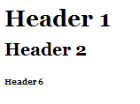
Markdown Examples
Markdown Syntax:
# Header 1 #
## Header 2 ##
###### Header 6
Output
HTML Syntax:
<h1>Header 1</h1>
<h2>Header 2</h2>
<h6>Header 6</h6>

Slide 56
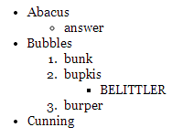
Markdown Examples (cont.)
Markdown Syntax:
HTML Syntax:
* Abacus
* answer
* Bubbles
1. bunk
2. bupkis
* BELITTLER
3. burper
* Cunning
<ul>
<li>Abacus
<ul><li>answer</li></ul></li>
<li>Bubbles
<ol><li>bunk</li>
<li>bupkis
<ul><li>BELITTLER</li></ul></li>
<li>burper</li></ol></li>
<li>Cunning</li>
</ul>
Output

Slide 57
Markdown
Most blogging platforms support Markdown syntax
Examples:
Wordpress
tumblr
Ghost
Dropplets

Slide 58
Markdown
To know more about Markdown, refer:
http://whatismarkdown.com/
http://daringfireball.net/projects/markdown/
To learn more about it’s syntax, refer:
http://daringfireball.net/projects/markdown/syntax

Slide 59
Summary, Review, & Questions…

