Slide 1
IS1500: Introduction to Web Development
Search Engine Optimization
Martin Schedlbauer, Ph.D.
m.schedlbauer@neu.edu
With content from David Hurd.

Slide 2
What is a Search Engine?
Search engines allow a user to locate website and resources through filtered searches based on key words, phrases, or topics.
Prior to the invention of search engines, a user had to know the exact URL of any website they wanted to visit.
Portals collect websites based on common themes.

Slide 3
Most Popular Search Engines
These are the most commonly used search engines in the U.S.
International users have different preferences, although Google and Bing are the most common search engines worldwide.

Slide 4
Search Engine Rankings
The chart shows the percentage of searches originating from the top search engines.
Google and Bing combined represents almost 90% of all searches.
U.S. users conducted more than 12.5 billions searches in Google versus 3.4 billion with Bing out of a total of 18.7 billion.

Slide 5
How Do Search Engines Work?
There are three basic steps taken by a search engine to include a website it its database:
Crawling
Indexing
Ranking & Retrieval

Slide 6
Crawling
Search engines uses automated bots called spiders that visit a website and scan each page on the site:
Page title
Images
Keywords
The spider also scans any pages to which the website has links, i.e., it traverses the web.

Slide 7
Crawling (cont.)
The page information is then stored in the search engine’s database, including in some cases a copy of each page (called a page cache.)
Websites are frequently re-crawled to keep the search database up-to-date.
There are ways to mark a page as “hidden” and not have it visited by a bot.

Slide 8
Indexing
Indexing is the process of taking the crawled pages and storing them in a database for fast retrieval.
A simple index is a keyword index, where each word on a page is put into the keyword database.
Keyword searching can then find the pages containing the keyword quickly.

Slide 9
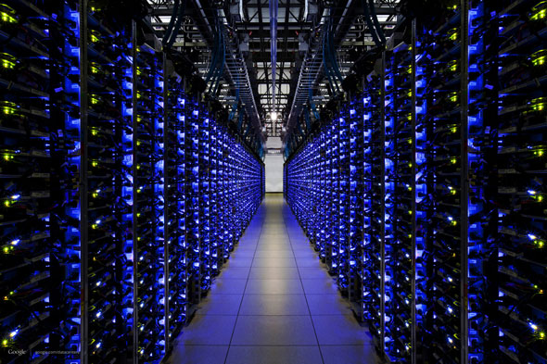
Indexing (cont.)
Search engines not only store keywords, but also keyword distances and similarities.
Indexing billions of pages requires massive databases in vast data centers.
Inside a Google data center

Slide 10
Retrieval
When a user searches for websites they commonly do so through keywords:
The search engine uses its index database to find matching websites and then displays them in ranked order of likely interest.

Slide 11
Ranking
Ranking is based on a combination of:
Number of times the keywords appear in a page
Age of content
Number of links to the page
The actual search algorithm used by each search engine is generally a “trade secret”.
Some search engines produce better results and display pages that are more likely to be relevant to the user.

Slide 12
What is SEO?
SEO = Search Engine Optimization
SEO improves the chance that a search engine finds a website and that it is placed at the top of its results.
SEO helps websites receive more visitors who start their web browsing with a search engine.
Different search engine have different strategies for ranking search results.

Slide 13
Use of Meta Tags
Meta tags allow the author of a page to specify keywords and concepts under which the page should be indexed search engines.
Most search engines require that the meta tags match words and content on the page to avoid “keyword stuffing” and artificially increase a page’s ranking.

Slide 14
Meta Tags
Meta Tag | Definition and Use
<title>page title</title> | The title of the page
<meta name="description" content="summary" /> | Page description and summary. In The description is displayed in the summary of the result.
<meta name="keywords" content="keyword 1, keyword 2" /> | Search indexing keywords
It is notable that Google and Bing generally ignore the <meta> keywords tag and instead rely on their own analysis of the words on the page.

Slide 15
Meta Tag: Description
The description is displayed in the search engine results page (SERP) and should be limited to 155 characters.
If the description is empty, Google and Bing will “craft” one for you, but it may not be what how you want your page summarized.
<meta name="description" content="Awesome Description Here">

Slide 16
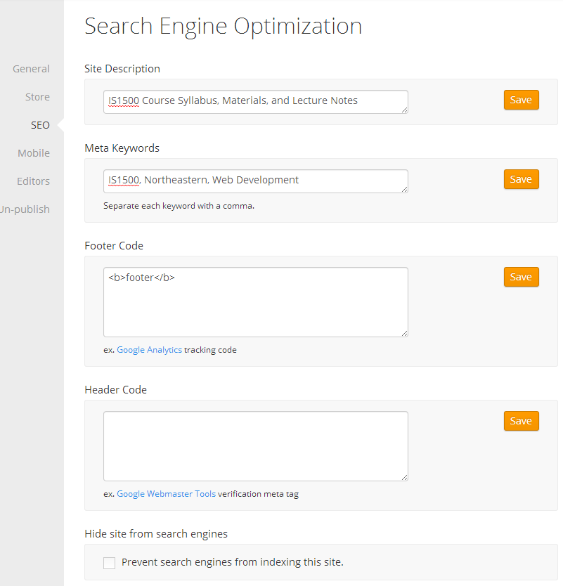
Defining Site-Wide Meta Tags
Weebly allows meta tags for the entire site and as well as each page.
Weebly also provides a place for custom page headers and footers in which Google Analytics code can be embedded.

Slide 17
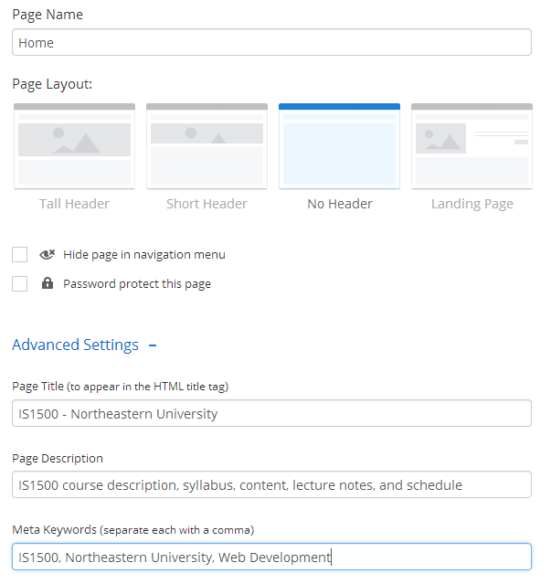
Defining Page Meta Tags
Weebly allows each page to have unique:
Page title
Page description
Meta keywords
Footer
Header
Pages can be individually excluded from search engine crawlers.

Slide 18
Other Factors Influencing SERP
In particular, Google ranks pages based on:
How many incoming links it has, i.e., how many reputable websites point to your site
Google punishes sites that are linked to my reciprocal aggregator sites that intend to “fool” the indexing process
Sites that use well formed and correct HTML5 generally get scored higher
Attempting keyword stuffing results in a site being punished and its rank reduced

Slide 19
Getting better SERPs
Google, Bing, and many other search engines use algorithms to rank pages and produce SERPs.
Mahalo is a search engine that employs volunteers using human judgment to create SERPs.

Slide 20
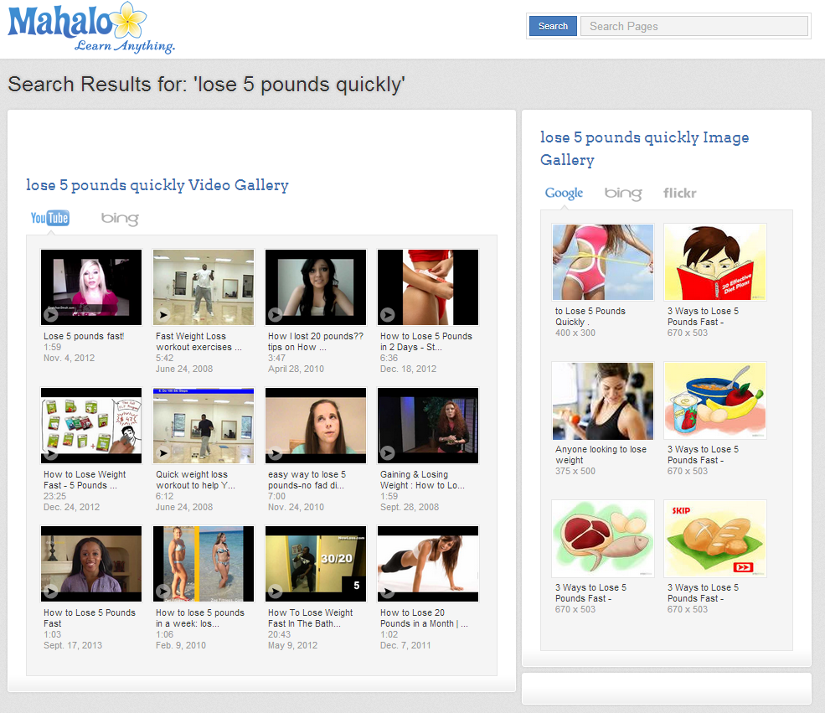
Mahalo: Human SERPs

Slide 21
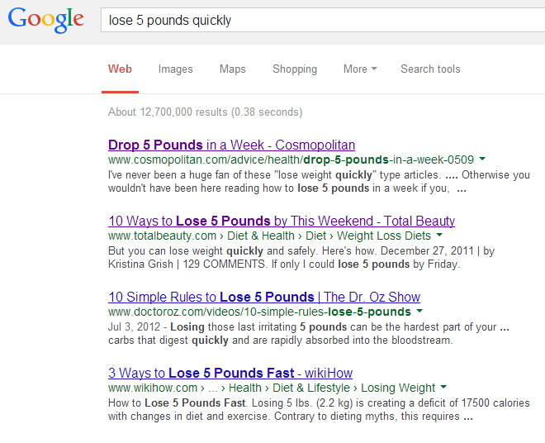
Google: Algorithmic SERPs

Slide 22
Google Hacks
Search engines have become a lot more than just a search tool.
In particular, Google has many “hacks” and tips that make Google a productivity tool and the starting page for everything “web”.

Slide 23
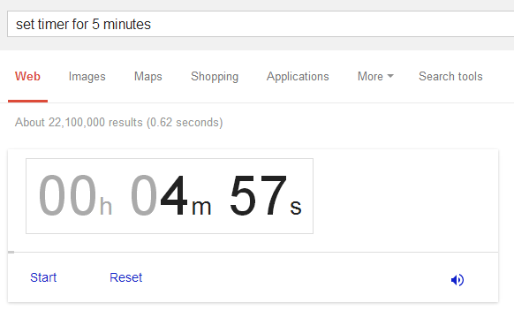
Google Hack: Set Timers
Type in “set timer” or “set timer for” to set a timer:

Slide 24
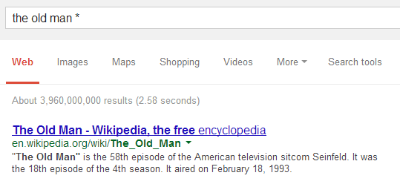
Google Hack: Wild Cards
Searches can include wild cards that matches missing words:

Slide 25
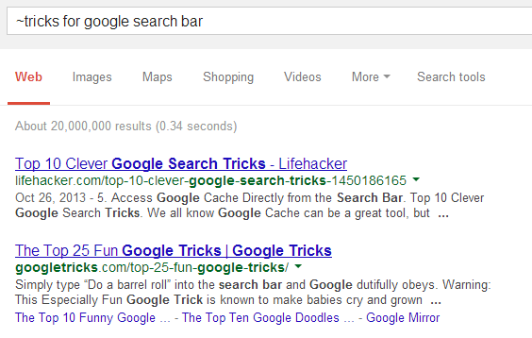
Google Hack: Similar To
Adding a ~ in front of a word will search for similar terms and synonyms:

Slide 26
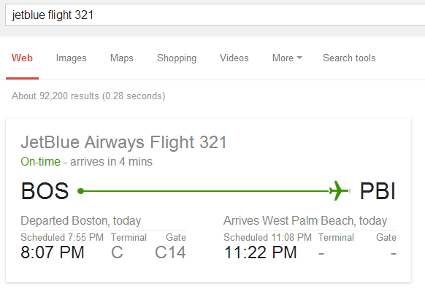
Google Hack: Flight Times
Google has information regarding most flights.
Search by typing in airline and flight number:

Slide 27
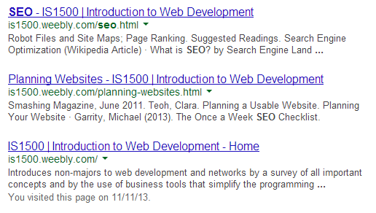
Google Hack: Specific Sites
Instead of searching the entire web for a term, you can limit the search to a specific site using the site:url search term:

Slide 28
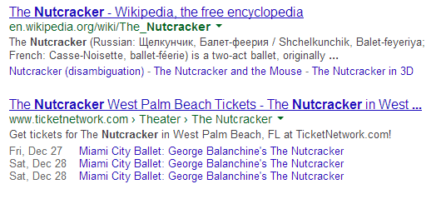
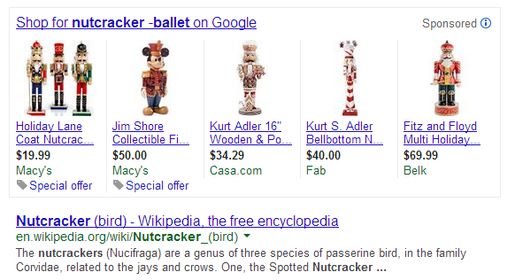
Google Hack: Exclude Words
When searching for a term the results may include sites that are not of interest.
Exclude keywords by prefixing them with “-”:

Slide 29
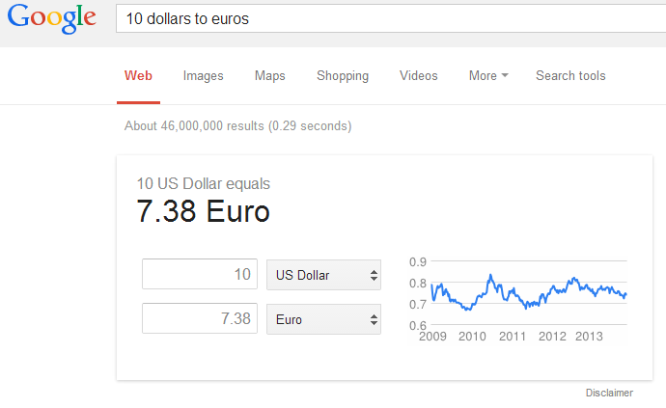
Google Hack: Convert Units
Conversion of units of measurement or conversion from one currency into another:
Examples:
3 meters in feet
10 dollars to euros
3 oz into tablespoons
1 ga into liters

Slide 30
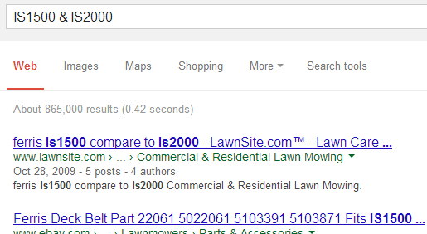
Google Hack: Boolean Logic
Add Boolean logic to search expressions with AND and OR:
Find either IS1500 or IS2000 with:
IS1500 | IS2000
Find both IS1500 and IS2000 with:
IS1500 & IS2000

Slide 31
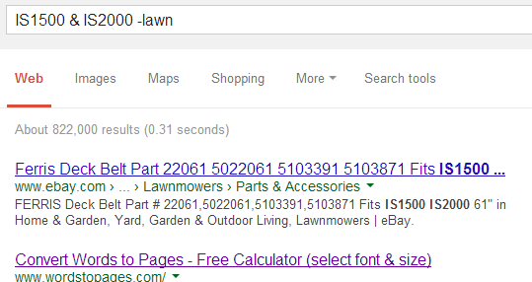
Google Hack: Compound Search
Combine & and | with exact expression and exclusion:
IS1500 & IS2000 -lawn

Slide 32
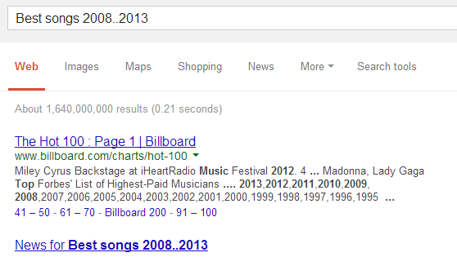
Google Hack: Date Range
Entering two dates between .. restricts the search results to that date range:
Best songs 2008..2013

Slide 33
Google Hack: Exact Phrase
Entering the search:
Javascript number conversion
will result in pages that contain any of these words, although pages that contain them in that sequence or close proximity will match first.
Entering:
“Javascript number conversion”
will result in pages containing that exact phrase.

Slide 34
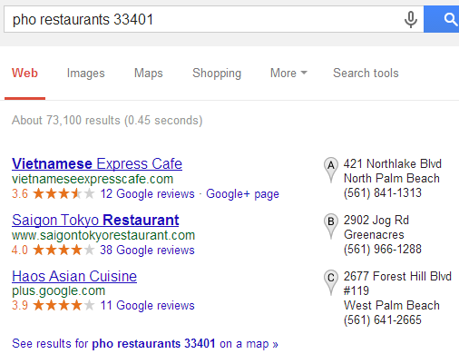
Google Hack: Search by Location
To restrict the search results to a particular geographic location, enter the zip code or area code.
Enter just the zip code and Google will supply the name of the city.

Slide 35
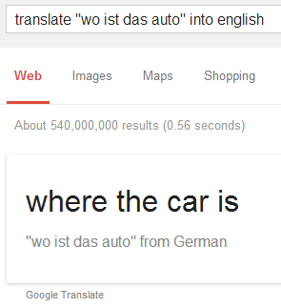
Google Hack: Translation
While the dedicated translate.google.com site is available for language translation, quick translations can be accessed via the search box.
Google attempts to detect the source language automatically.
The “into English” can be omitted and English is assumed.

Slide 36
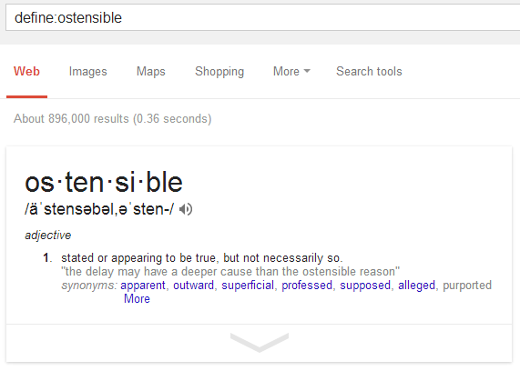
Google Hack: Define
Get the definition of any word by using:
define:word
Example:

Slide 37
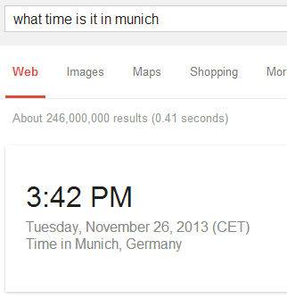
Google Hack: Time Zones
To find the time in any region or city on Earth, type the phrase: “what time is it in …” followed by the city.

Slide 38
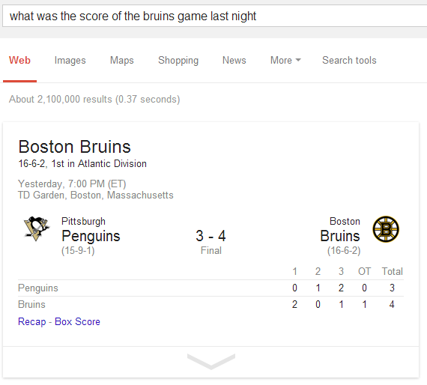
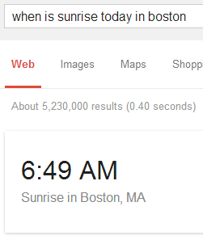
Google Hack: What Questions
Google has a solid natural language interface that understands questions that are typed in or spoken:

Slide 39
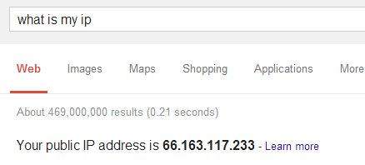
Google Hack: Find IP
To get the IP address of your own computer, use:
what is my ip

Slide 40
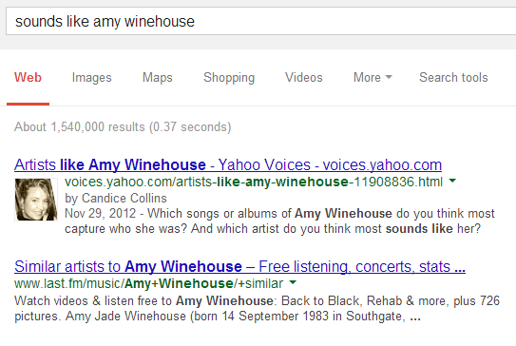
Google Hack: Sounds Like
To find songs that are similar to others use the phrase “sounds like”:

Slide 41
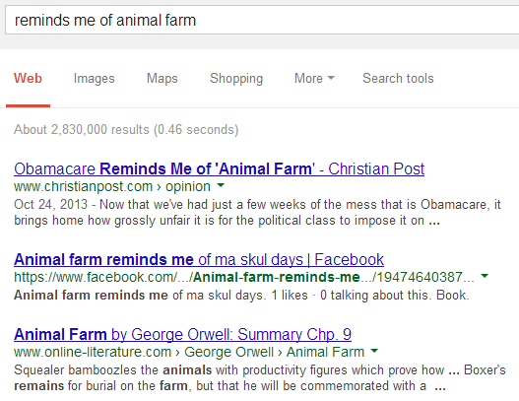
Google Hack: Reminds me of
To find things are similar to others, use the search phrase: “reminds me of”:

Slide 42
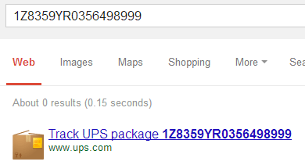
Google Hack: Track Packages
Track packages on UPS, USPS, and FedEx by typing in the tracking number:

Slide 43
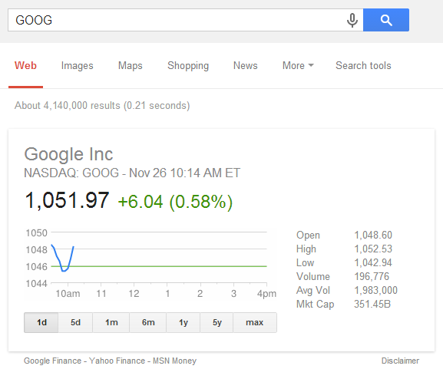
Google Hack: Stock Quotes
Type any ticker symbol into the search box and get real time updates for that security:

Slide 44
Google Hack: Search Images
To search for people or other types of images based on a keyword, add the search qualifier &imgtype=face to the end of the search URL.
The key to using this feature is to conduct the search first and then modify the URL.

Slide 45
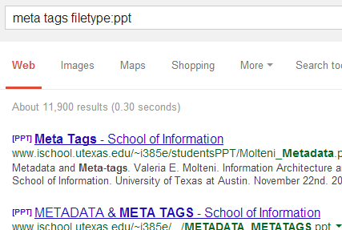
Google Hack: Search by File Type
To find specific types of files, such as PDFs, PPTs, or images add filetype: and the 3 letter file abbreviation:

Slide 46
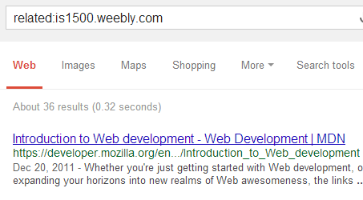
Google Hack: Related Sites
Use the related: operator to find pages that have similar content to another site:

Slide 47
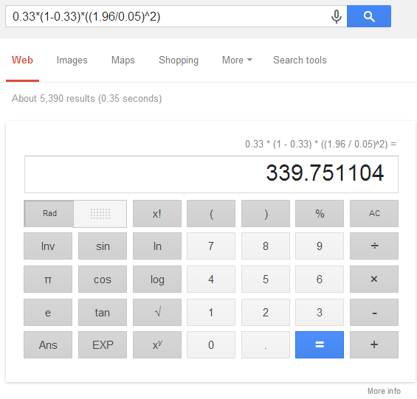
Google Hack: Calculator
Enter any match equation into the search box and Google calculates the answer.
Google has a full calculator as well.

Slide 48
Google Databases
Google has databases of specific types of information:
Videos: videos.google.com
Books: books.google.com
Blogs: blogs.google.com
Flights: flights.google.com
Discussions: discussions.google.com
Patents: patents.google.com
Academic articles: scholar.google.com

Slide 49
Google Hack: Cached Pages
Google stores full copies of pages and websites in its cache.
When a website is down, has been removed, or is blocked, then an older version of the page may exist in Google’s cache.

Slide 50
Summary, Review, & Questions…

