Slide 1
IS1500: Introduction to Web Development
Basic JavaScript
Martin Schedlbauer, Ph.D.
m.schedlbauer@neu.edu

Slide 2
JavaScript Essentials
Basic JavaScript

Slide 3
What is JavaScript?
JavaScript is a popular scripting language designed to add interactivity to HTML pages.
JavaScript code is inserted into HTML pages and is executed by the web browser.
Many HTML designers are not programmers, but JavaScript has a very simple syntax allowing anyone to put small "snippets" of JavaScript code into HTML pages.

Slide 4
JavaScript and Web Development
JavaScript is one of 3 languages all web developers must understand:
HTML to define the content of web pages
CSS to specify the layout of web pages and style of HTML elements
JavaScript to program the behavior of web pages
This module is about JavaScript and how JavaScript interacts with HTML and CSS.

Slide 5
What Can JavaScript Do?
JavaScript can:
Change the content or style of HTML elements
React to HTML events
Delete and create HTML elements
Read form fields and process them, e.g., to validate them before sending them to the forms processor on the server

Slide 6
JavaScript Essentials
JavaScript code must be placed into a <script> section.
<p>
JavaScript can write directly into the HTML output stream:
</p>
<script>
document.write("<p>This is a paragraph.</p>");
</script>

Slide 7
JavaScript and HTML Elements
JavaScript can change HTML elements:
<p id="demo">
JavaScript can change the content of an HTML element.
</p>
<script>
x=document.getElementById("demo"); // Find an element
x.innerHTML="Hello"; // Change the content
</script>

Slide 8
JavaScript Functions
Code is generally organized into functions, which act like mini programs.
Functions must be called; otherwise the code in the function does not execute.
….
<script>
function functionName ()
{
}
</script>

Slide 9
Components of a Function
A JavaScript function is defined with the keyword function.
After the name comes the parameter list that contains any input data that is passed to the function.
In the simplest case there are none, but the list must still be specified as ().
The “body” of the function contains the code that is run. It must be within curly braces { and }.

Slide 10
Function Names
Function names are specified with an identifier so a few rules must be followed:
You can’t name a function the same as a JavaScript keyword, i.e., stuff built into the language such as “function”, “if”, “for”, “while”
You must start the function name with a letter
You can mix upper and lower case letters and numbers, but not special characters like $, #, @, &, ^, %, *, !, space, and so forth

Slide 11
Function Naming Best Practices
Name your functions with a name that is suggestive of what it does.
Start with a lower case, then mix upper and lower case, but NEVER have a space in your function name.
Good function names:
processForm, doPageLoad, runValidation
Bad function names:
dpl, d1, d2, func1, myFunc

Slide 12
JavaScript Events
JavaScript functions can be called in response to an event.
When the event occurs, the function’s code is executed, but not until the event occurs.
Most HTML elements and all HTML form elements support events that are unique to them.

Slide 13
Button Events
The <button> element support this important events:
onClick – called when the button is pressed¹
¹Case does not matter as the event is specified in HTML and HTML is not case sensitive, so onclick and onClick are the same.

Slide 14
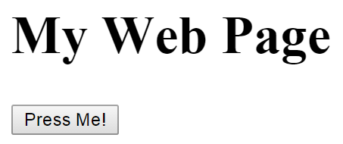
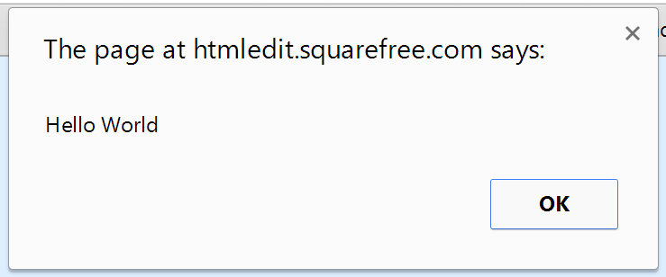
Example: Hello World!
This simple JavaScript code displays an alert message that is called when a user presses the button.
<!DOCTYPE html> <html>
<head> <script> function procClick()
{ alert("Hello World"); } </script> </head>
<body>
<h1>My Web Page</h1>
<button type="button" onclick="procClick ()">Press Me!</button>
</body> </html>
Even though this function appears before the HTML code it is not “run” until the function is explicitly called

Slide 15
The alert() Function
alert() is one of the many built-in functions.
It displays a message in a popup dialog box when called.
While alert() is not generally useful for user interfaces and web pages, it can be very helpful in “debugging” your code.
Insert an alert() at the beginning of your JavaScript function to see if the function is set up correctly. If you see the alert box you know that your function is being called.

Slide 16
Other HTML Elements with Events
Most HTML elements support events:
<img>
<button>
<input>
Even…
<p>
<body>
<form>

Slide 17
Common Questions
Where do I put the <script> section?
Anywhere is fine, but generally at the top of the page before the <body> tag.
Can I have more than one <script> section?
Yes, but most HTML pages have just one.
Does spelling and case matter?
Yes! JavaScript is case sensitive, so there’s a big difference between function and Function.
Does the order with which I write the code statements matter?
Most definitely! Statements are executed in the order you write them.
The code in my function doesn’t work. What’s wrong?
Are you calling the function? Did you put an alert() call into the function to see if it’s getting called? Check the spelling of your code…

Slide 18
JavaScript Statements
Basic JavaScript

Slide 19
Variables
Variables hold temporary values such as form fields, results of calculations, or constants.
A variable should (but doesn’t have to be) declared before it’s used for the first time.
JavaScript is a loosely typed language where variables can take on whatever data type they need based on the value they old.
Naming of variables follows the same restrictions as the naming of functions.
Variables can be initialized when they are declared.

Slide 20
Example of Variables Declarations
….
<script>
function functionName ()
{
var hisAge = 20; // declare variable
var herAge = 22; // declare variable
var ageDiff; // no initialization
ageDiff = hisAge – herAge; // calculation
}
</script>

Slide 21
Example of Variables Declarations
…
<script>
function functionName ()
{
var fName = "John";
var lName = "Doe";
fullName = fName + " " + lName; // make a full name
alert(fullName);
}
</script>

Slide 22
Variable Scope
Variables are only known within a context:
Local variables are known within a function
Global variables are known within an HTML page
Local variables are created and initialized when a function is entered and are “destroyed” when the function completes.
Global variables are around for the entire time an HTML page is displayed by the browser.

Slide 23
Global vs Local Variables
…
<script>
var globalVar = 1;
function functionName ()
{
var localVar = 1;
localVar = localVar + 1; // add 1 to the variable
globalVar = globalVar + 1; // add 1 to global var
}
</script>
What happens the next time the function is called? What will the values of the variables be?

Slide 24
Scope: Local vs Global
When you refer to a local variable that has the same name as a global variable, JavaScript provides the one that’s “closest”, i.e., the local one – local variables “override” global variables.
…
<script>
var globalVar = 1;
function functionName ()
{
var globalVar = 99;
globalVar = globalVar + 1; // which globalVar?
}
</script>

Slide 25
Comments
Not all JavaScript statements are "executable commands".
Anything after double slashes // is treated as a comment, and is ignored, and not executed:
// y = x + 6; code is commented out

Slide 26
Separating Statements
Statements must be separated in JavaScript with a semi-colon (;)
There is NEVER a semi-colon (;) before a curly brace { or at the end of a curly brace }.
Don’t write this!
….
<script>
function functionName ();
{
};
</script>

Slide 27
Initializing Variables
Variables should be initialized before they are first used.
If they aren’t initialized they are set to their default “null” value which is 0 for numbers and "" for strings (text values).
Values are assigned to variables using the “=“ operator.
Do NOT confuse = with == we’ll discuss later.

Slide 28
Arithmetic Operators
Numeric variables can be used in calculations.
JavaScript recognizes the usual arithmetic operators:
Addition: +
Subtraction: -
Division: /
Multiplication: *
Modulus: %

Slide 29
JavaScript: if
The if statement selects which code to run based on a condition.
….
<script>
function functionName ()
{
if (condition is true)
{
do this code here
}
}
</script>

Slide 30
JavaScript: if-else
The if-else statement selects one of two code blocks to run based on a condition.
…
<script>
function functionName ()
{
if (condition is true)
{
do this code if condition is TRUE
} else {
do this code if condition is NOT true
}
}
</script>

Slide 31
Example: if Statement
….
<script>
function functionName ()
{
var myAge = 25;
var yourAge = 30;
if (myAge > yourAge)
{
alert("I’m older than you!!!");
}
}
</script>

Slide 32
Example: If-Else
….
<script>
function functionName ()
{
var myAge = 25;
var yourAge = 30;
if (myAge > yourAge)
{
alert("I’m older than you!!!");
} else {
alert("I’m younger than you!!!");
}
}
</script>

Slide 33
Logical Operators
Conditions in JavaScript rely on logical operators:
Greater Than: >
Less Than: <
Equal: ==
Less Than or Equal: <=
Greater Than or Equal: >=
Not Equal: !=

Slide 34
Relational Operators
Compound conditions can be created with relational operators:
AND (both conditions must be true): &&
OR (either or both conditions can be true): ||
NOT (negation of condition): !
As a side note, there is no XOR (exclusive or) in JavaScript.

Slide 35
Example: Relational Operators
….
<script>
function functionName ()
{
var myAge = 25;
var yourAge = 30;
if ((myAge > yourAge) && (myAge > 0))
{
alert("I’m older than you!!!");
} else {
alert("I’m younger than you!!!");
}
}
</script>

Slide 36
Indentation
Indentation is part of programming style.
A good programming style can make programs easier to read and “debug”, i.e., find mistakes.
Generally write the { on the next line and then indent two spaces.
Line up the closing } with its opening {.

Slide 37
Good Style
…
<script>
function functionName ()
{
var myAge = 25;
var yourAge = 30;
if (myAge > yourAge)
{
alert("I’m older than you!!!");
} else {
alert("I’m younger than you!!!");
}
}
</script>

Slide 38
Bad Style
…
<script>
function functionName(){
var myAge = 25;
var yourAge = 30;
if (myAge > yourAge)
{
alert("I’m older than you!!!");
} else { alert("I’m younger than you!!!");
}
}
</script>
It’s difficult to see the “structure” and flow of the code; it’s correct and it will run correctly but it’s hard to read and find logic mistakes.

Slide 39
Reading Input from <input>
JavaScript can read anything typed into an <input> field.
JavaScript needs to know the id of the <input> element and then use the DOM to find the input field and read its value.
The value, once read, is generally stored in a variable.

Slide 40
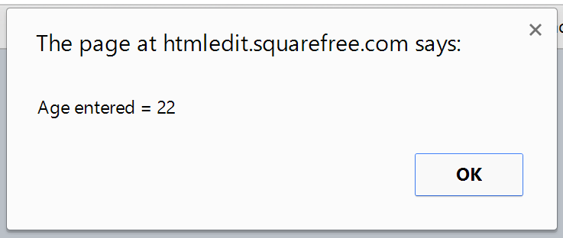
Example: Reading Input
Enter Age: <input type="text" id="ageField" />
<button type="button" onclick="checkAge()">Check Age</button>
<script>
function checkAge()
{
// declare a variable for holding the age value
var age;
// get the entered age value
age = document.getElementById("ageField").value;
// display the age to check if everything is working
alert("Age entered = " + age);
}
</script>

Slide 41
Accessing HTML Elements
HTML elements are accessed through the object document and then using the function:
getElementById(id)
JavaScript finds the element through its id.
However, document.getElementById(id) retrieves the ENTIRE HTML element.
Next, you need to read the value of the element by reading the .value property.

Slide 42
Alternative Code
Enter Age: <input type="text" id="ageField" />
<button type="button" onclick="checkAge()">Check Age</button>
<script>
function checkAge()
{
var ageElement;
// declare a variable for holding the age value
var age;
ageElement = document.getElementById("ageField");
// get the entered age value
age = ageElement.value;
// display the age to check if everything is working
alert("Age entered = " + age);
}
</script>
This code does the same as the previous code except that it uses an intermediary statement which may make the code easier to read and understand.

Slide 43
Name vs ID vs Value
The <input> tag has three key attributes:
name is the attribute by which the field is known to a server-side forms processing program such as a PHP program
id specifies a unique identifier that’s used by JavaScript and CSS to identify the element
value is what’s in the input field

Slide 44
JavaScript and Input Testing
JavaScript can test the input into form fields:
<input id="demo" type="text" />
<script>
function myFunction()
{
var field = document.getElementById("demo").value;
if(isNaN(field))
{
alert("Not Numeric");
}
}
</script>
<button type="button" onClick="myFunction()">Click Me!</button>

Slide 45
The isNaN() Function
isNaN(value) is another built-in function.
It returns a Boolean value:
True if the value that is passed to it is NOT a number
False if the value is a number
Remember that JavaScript is a loosely-typed language that does not specify the type of data held in a variable.

Slide 46
Finger Exercise…
Write a JavaScript program that gets the user’s age through an input and then checks if that person is of legal drinking age. Use an alert to tell the user if they can legally drink.
Improve your program by asking for a country and then checking if the person is in the US in which case the drinking age is 21 otherwise it should be 18.

Slide 47
External Scripts
JavaScript code can also be saved in an external file and loaded in a page.
External scripts are practical when the same code is used in many different web pages.
JavaScript files have the file extension .js.
To use an external script, put the name of the script file in the source (src) attribute of the <script> tag.

Slide 48
Example: External JavaScript
<!DOCTYPE html> <html> <body> <script src="extScript.js"></script> </body> </html>
You can place an external script reference in the <head> or the <body>; works the same regardless.
The script will behave as if it was located exactly where you put the reference in the HTML document.

Slide 49
Finger Exercise…
Rewrite your previous example, but now put the code into an external file and load it. It should work just like before if you did everything correctly.

Slide 50
Outputting Results
<p>Click the button to create a variable, and display the result.</p>
<button onclick="myFunction()">Try it</button>
<p id="demo"></p>
<script>
function myFunction()
{
var carname="Volvo";
document.getElementById("demo").innerHTML=carname;
}
</script>

Slide 51
Manipulating HTML Elements
Use document.getElementById() to access an HTML element through its id attribute.
HTML elements like <p> contain text between the beginning and the end tag, e.g.:
This text can be read or changed by manipulating the innerHTML property.
<p id="myText">My First Paragraph</p>

Slide 52
Example: Manipulating HTML
<!DOCTYPE html> <html> <body> <h1>Accessing HTML Elements</h1> <p id="myText">My First Paragraph</p> <script> document.getElementById("myText").innerHTML = "New Text!!!"; </script> </body> </html>

Slide 53
JavaScript and Styles
JavaScript can change styles (color, font, etc.):
<p id="demo">
JavaScript can change the style of HTML elements.
</p>
<script>
function myFunction()
{
document.getElementById("demo").style.color="#ff0000";
}
</script>
<button type="button" onclick="myFunction()">Click Me!</button>

Slide 54
Embedding JavaScript in Weebly
Basic JavaScript

Slide 55
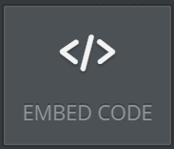
Adding JavaScript to Weebly
Use the Embed Code widget to custom HTML and JavaScript to a Weebly page:

Slide 56
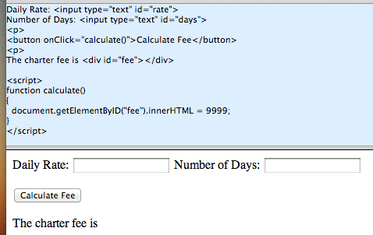
Testing JavaScript
You need to publish your Weebly site in order to run JavaScript.
Use the online HTML Editor to develop your JavaScript and then paste it into Weebly.

Slide 57
Summary, Review, & Questions…

